Slide 1


Unit-2
Problems, state space search &
Heuristic search techniques
ARTIFICIAL INTELLIGENCE
(3161608)
Assistant Professor
IT-ICT Department, LJIET
prayag.patel@ljinstitutes.edu.in
Mr. Prayag Patel

Slide 2
Outline
Problem, Problem space and Search
Define problem as a state space search: Chess Game
Define problem as a state space search: Water Jug Problem
Production System
AI Problem characteristics
TYPES of Production System
Issues in Design of search programs
Additional Problems
Heuristic Search Technique
Mr. Prayag Patel
Department: IT/ICT-LJIET

Slide 3
To solve Problem
To Build a system to solve a particular problem we need to do Four things:
Initial & Final state
Define the Problem Precisely
Analyse the Problem
Isolate and represent the task knowledge
Choose the best problem solving technique
Finding key features
Mr. Prayag Patel
Department: IT/ICT-LJIET

Slide 4
Problem, Problem space and Search
The scenario which is given is called as problem.
The steps to reach from initial state to goal state is called as problem space.
The steps we follow to reach from initial state to goal state is called as search.
Mr. Prayag Patel
Department: IT/ICT-LJIET

Slide 5
Define the Problem
X | X | O
X | O
 | O
Human
Max
WIN
X | X | O
X | O | X
 | O
X | X | O
X | O
X | O
X | X | O
X | O
 | O | X
Computer
Min
WIN
WIN
X | X | O
X | O | X
O | O
X | X | O
X | O | X
 | O | O
X | X | O
X | O
O | O | X
X | X | O
X | O | O
 | O | X
Human
Max
WIN
WIN
X | X | O
X | O | X
X | O | O
X | X | O
X | O | O
X | O | X
Computer
Min
Mr. Prayag Patel
Department: IT/ICT-LJIET

Slide 6
Define the Problem
Defining the Problem as a state space search
Initial State
Operators(Rules)
Goal State
Mr. Prayag Patel
Department: IT/ICT-LJIET

Slide 7
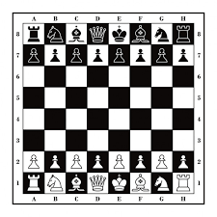
Chess Game
Initial State
Operations(Rules)
Goal State
The starting position of the chess board,
The rules that define legal moves, and
The board position that represents a win
Mr. Prayag Patel
Department: IT/ICT-LJIET

Slide 8
Chess Game
Initial State:
an 8 X 8 array square in which each element square (x, y), (x varying from 1 to 8 & y varying from 1 to 8) describes the board position of an appropriate piece in the official chess opening position.
Operations(Rules):
Legal moves are defined by a set of rules.
Goal State:
The goal can be any board position in which the opponent does not have a legal move and his or her “King” is under attack.
Mr. Prayag Patel
Department: IT/ICT-LJIET

Slide 9
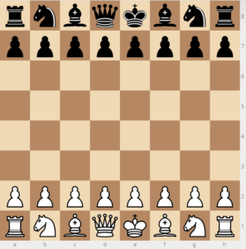
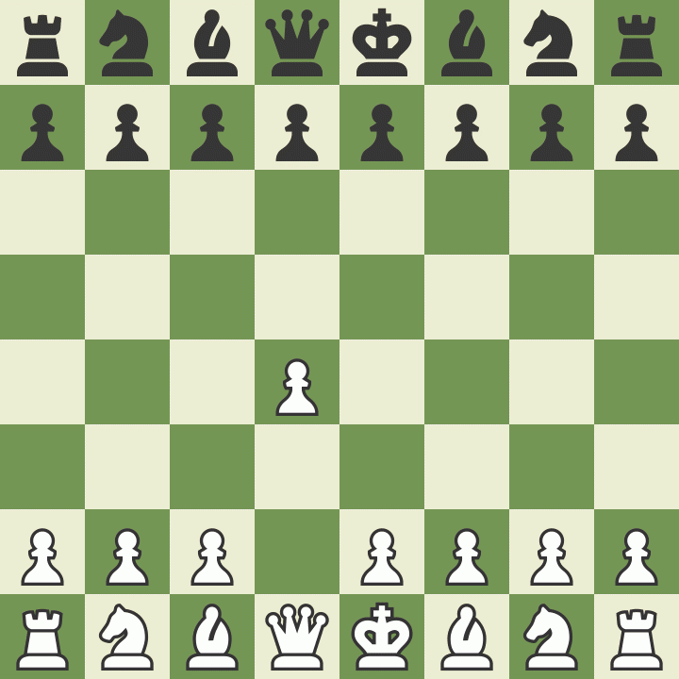
One legal Chess move
Mr. Prayag Patel
Department: IT/ICT-LJIET

Slide 10
One legal Chess move
White pawn at
square(file d, rank 2)
AND
square(file d, rank 3) is empty
AND
square(file d, rank 4) is empty
Move pawn from square(file d, rank 2) to square(file d, rank 4)
Mr. Prayag Patel
Department: IT/ICT-LJIET

Slide 11
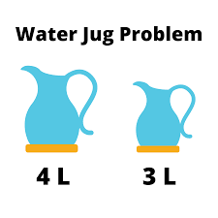
A Water Jug Problem
A Water Jug Problem:
You are given two jugs, a 4-gallon one and a 3-gallon one,
A pump which has unlimited water which you can use to fill the jug, and the ground on which water may be poured.
Neither jug has any measuring markings on it.
How can you get exactly 2 gallons of water in the 4-gallon jug?
Here the initial state is (0, 0).
The goal state is (2, n).
Mr. Prayag Patel
Department: IT/ICT-LJIET

Slide 12
A Water Jug Problem
The state space for this problem can be described as the set of ordered pairs of integers(x,y), such that
(4 gallon jug , 3 gallon jug)
  x = 0,1,2,3,4
  y = 0,1,2,3
Start state(0,0)
Goal state(2,n)
Rules
Mr. Prayag Patel
Department: IT/ICT-LJIET

Slide 13
A Water Jug Problem
Mr. Prayag Patel
Department: IT/ICT-LJIET

Slide 14
A Water Jug Problem
Mr. Prayag Patel
Department: IT/ICT-LJIET

Slide 15
A Water Jug Problem
Mr. Prayag Patel
Department: IT/ICT-LJIET

Slide 16
A Water Jug Problem
Mr. Prayag Patel
Department: IT/ICT-LJIET

Slide 17
A Water Jug Problem
Mr. Prayag Patel
Department: IT/ICT-LJIET

Slide 18
A Water Jug Problem
Mr. Prayag Patel
Department: IT/ICT-LJIET

Slide 19
A Water Jug Problem
Mr. Prayag Patel
Department: IT/ICT-LJIET

Slide 20
A Water Jug Problem
Mr. Prayag Patel
Department: IT/ICT-LJIET

Slide 21
A Water Jug Problem
Mr. Prayag Patel
Department: IT/ICT-LJIET

Slide 22
A Water Jug Problem
Mr. Prayag Patel
Department: IT/ICT-LJIET

Slide 23
A Water Jug Problem
Mr. Prayag Patel
Department: IT/ICT-LJIET

Slide 24
A Water Jug Problem
Mr. Prayag Patel
Department: IT/ICT-LJIET

Slide 25
A Water Jug Problem
How can you get exactly 2-Gallon water into 4-Gallon jug?
Water in 4-Gallon jug | Water in 3-Gallon jug | Rule applied
0 | 0 | Rule-2
0 | 3 | Rule-9
3 | 0 | Rule-2
3 | 3 | Rule-7
4 | 2 | Rule-5
0 | 2 | Rule-9
2 | 0 | Goal state
Mr. Prayag Patel
Department: IT/ICT-LJIET

Slide 26
A Water Jug Problem
How can you get exactly 2-Gallon water into 4-Gallon jug?
Water in 4-Gallon jug | Water in 3-Gallon jug | Rule applied
0 | 0 | Rule-1
4 | 0 | Rule-8
1 | 3 | Rule-6
1 | 0 | Rule-10
0 | 1 | Rule-1
4 | 1 | Rule-8
2 | 3 | Goal State
Mr. Prayag Patel
Department: IT/ICT-LJIET

Slide 27
Production System
Mr. Prayag Patel

Slide 28
Production System
Production system provides a structure, which is useful to arrange AI programs in a way that facilitates describing and performing search.
A production system consists of:
A set of rules, each consisting of a left side that determines the applicability of the rule and a right side that describes the operation to be performed if that rule is applied.
One or more knowledge/databases that contain whatever information is appropriate for the particular task. Some parts of the database may be permanent, while other parts of it may pertain only to the solution of the current problem.
A control strategy that specifies the order in which the rules will be compared to the database and a way of resolving the conflicts that arise when several rules match at once.
A rule applier which is the computational system that implements the control strategy and applies the rules.
Mr. Prayag Patel
Department: IT/ICT-LJIET

Slide 29
Control strategy
Which rule to apply next in the process of search for a solution if multiple rules are applicable. This is decided by control strategy.
Requirements of good control strategy:
It should cause motion
  Otherwise, it will never lead to a solution.
It should be systematic
  Otherwise, it may use more steps than necessary
It is efficient
Find a good, but not necessarily the best, answer.
Some well-known control strategies are BFS, DFS, Heuristic search….
Mr. Prayag Patel
Department: IT/ICT-LJIET

Slide 30
Search Strategies
Two types:
1. Uninformed search (blind search)
Having no information about the number of steps from the current state to the goal. (BFS, DFS)
2. Informed search (heuristic search)
More efficient than uninformed search.
Mr. Prayag Patel
Department: IT/ICT-LJIET

Slide 31
Breadth First Search
Algorithm: Breadth First Search
Create a variable called NODE_LIST and set it to initial state.
Until a goal state is found or NODE_LIST is empty:
(a) Remove first element from NODE_LIST & call it ‘E’.
(b) For each way that each rule can match the state
described in ‘E’ do:
(i) Apply rule to generate next state.
(ii) If new state is goal, then quit and return it.
(iii)Otherwise add new state to end of NODE_LIST.
Mr. Prayag Patel
Department: IT/ICT-LJIET

Slide 32
Breadth First Search
(0,0)
(4,3) (0,0) (1,3) (4,3) (0,0) (3,0)
NODE_LIST:
(4,0)
(0,3)
(0,0) | (4,0) | (0,3) | (4,3) | (0,0) | (1,3) | ….
Mr. Prayag Patel
Department: IT/ICT-LJIET

Slide 33
Advantages of BFS
  If there is a solution, then BFS is guaranteed to find it.
  BFS will not follow path blindly.
Mr. Prayag Patel
Department: IT/ICT-LJIET

Slide 34
Depth First Search
Algorithm: Depth First Search
If initial state is goal state, then quit and return success.
Otherwise, do the following until success or failure is signaled:
(a) Generate a successor, ‘E’ of the initial state. If there
are no more successor, signal failure.
(b) Call dept_first_search with E as the initial state.
(c) If success is returned, signal success. Otherwise,
continue in loop.
Mr. Prayag Patel
Department: IT/ICT-LJIET

Slide 35
Depth First Search
(0,0) Initial state
(4,0) Successor:E Initial state
(4,3) Successor:E Initial state
Mr. Prayag Patel
Department: IT/ICT-LJIET

Slide 36
Advantages of DFS
DFS requires less memory.
By chance it may find a solution without examining
much of the search space at all, while in BFS all parts
of tree must be examined to level n before level n+1.
Mr. Prayag Patel
Department: IT/ICT-LJIET

Slide 37
Heuristic Search
In order to solve many problems efficiently, it is often necessary to compromise the requirements of mobility and systematicity and to construct a control structure that is no longer guaranteed to find the best answer but that will almost always find a very good answer.
Heuristic is a technique that improves the efficiency of a search process, possibly by sacrificing claims of completeness.
A heuristic function is a function that maps from problem state descriptions to measures of desirability, usually represented as numbers.
Well-designed heuristic functions can play an important part in efficiently guiding a search process toward a solution.
Mr. Prayag Patel
Department: IT/ICT-LJIET

Slide 38
Heuristic Search
The purpose of a heuristic function is to guide the search process in the most profitable direction by suggesting which path to follow first when more then one is available.
Mr. Prayag Patel
Department: IT/ICT-LJIET

Slide 39
Heuristic Search
Travelling salesman problem
“A salesman has a list of cities, each of which he must visit exactly once. There are direct roads between each pair of cities on the list. Find the route the salesman should follow for the shortest possible round trip that both starts and finishes at any one of the cities.”
A
1
10
B
D
E
5
5
15
5
C
Mr. Prayag Patel
Department: IT/ICT-LJIET

Slide 40
Heuristic Search
Travelling salesman problem
Applying Heuristic search to the travelling salesman problem, we produce the following procedure:
Arbitrarily select a starting city.
To select the next city, look at all cities yet not visited, select the nearest one.
Repeat step 2 until all cities have been visited.
A
1
10
B
D
E
5
5
15
5
C
Mr. Prayag Patel
Department: IT/ICT-LJIET

Slide 41
Advantages of Heuristic Search
Most of the time we require a good solution, not optimum.
Solution obtained by heuristics may not be very good in worst case, but worst case rarely arises.
Mr. Prayag Patel
Department: IT/ICT-LJIET

Slide 42
AI Problem characteristics
Mr. Prayag Patel

Slide 43
Problem characteristics
In order to choose most appropriate method for a particular problem, it is necessary to analyze problem along several key dimensions.
Is the problem decomposable into a set of sub problems?
Can solution steps be ignored or undone?
Is the problem’s universe predictable?
Is a good solution to the problem obvious without comparison to all other possible solutions?
Is the desirable solution a state of the world or a path to a state?
Is a large amount of knowledge absolutely required to solve a problem?
Is human interaction required?
Mr. Prayag Patel
Department: IT/ICT-LJIET

Slide 44
1. Is the problem decomposable?
Problem characteristics
  ∫(x² + 3x) dx
∫x² dx ∫3x dx
x³/3 3x²/2
  So, the problem is decomposable…
Mr. Prayag Patel
Department: IT/ICT-LJIET

Slide 45
1. Is the problem decomposable?
Problem characteristics
Blocks world problem
Initial state:
Goal state:
A
C
B
A
B
C
ON(C,A) ON(B,C) and ON(A,B)
Mr. Prayag Patel
Department: IT/ICT-LJIET

Slide 46
1. Is the problem decomposable?
Problem characteristics
A
C
B
A
B
C
Blocks world problem
  ON(B,C) and ON(A,B)
  ON(B,C) ON(A,B)
  ON(B,C) CLEAR(A) ON(A,B)
  So, the problem is not decomposable…
Mr. Prayag Patel
Department: IT/ICT-LJIET

Slide 47
2. Can solution steps be ignored or undone?
Problem characteristics
  There are three classes of problems.
  Ignorable (Theorem proving)
  Recoverable (8-Puzzle)
  Irrecoverable (Chess)
2 | 8 | 3
1 | 6 | 4
7 |  | 5
1 | 2 | 3
8 |  | 4
7 | 6 | 5
Mr. Prayag Patel
Department: IT/ICT-LJIET

Slide 48
2. Can solution steps be ignored or undone?
Problem characteristics
1. Ignorable (Theorem Proving)
Suppose we have proved some lemma in order to prove a theorem and eventually realized that lemma is no help at all, then ignore it and prove another lemma.
No Backtracking Required.
Solution steps can be ignored
Mr. Prayag Patel
Department: IT/ICT-LJIET

Slide 49
2. Can solution steps be ignored or undone?
Problem characteristics
  2. Recoverable (8-Puzzle)
Moves can be undone and backtracked
Recoverable!
Initial state:
Goal state:
2 | 8 | 3
1 | 6 | 4
7 |  | 5
1 | 2 | 3
8 |  | 4
7 | 6 | 5
Mr. Prayag Patel
Department: IT/ICT-LJIET

Slide 50
2. Can solution steps be ignored or undone?
Problem characteristics
  3. Irrecoverable (Chess)
Solution steps cannot be undone.
Great amount of planning Required.
Mr. Prayag Patel
Department: IT/ICT-LJIET

Slide 51
3. Is the universe predictable?
Problem characteristics
8-Puzzle
2 | 8 | 3
1 | 6 | 4
7 |  | 5
1 | 2 | 3
8 |  | 4
7 | 6 | 5
Universe predictable
Mr. Prayag Patel
Department: IT/ICT-LJIET

Slide 52
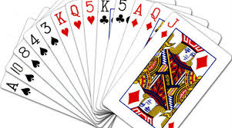
3. Is the universe predictable?
Problem characteristics
Playing Bridge
We cannot know exactly where all the cards are or what theother players will do on their turns.
Uncertain outcome!
Not Universe predictable
Mr. Prayag Patel
Department: IT/ICT-LJIET

Slide 53
4. Is a good solution absolute or relative?
Problem characteristics
Marcus was a man.
2. Marcus was a Pompeian.
3. Marcus was born in 40 A.D.
4. All men are mortal.
5. All Pompeians died when the volcano erupted in 79 A.D.
6. No mortal lives longer than 150 years.
It is now 1991 A.D.
Answer the question: Is Marcus alive?
Mr. Prayag Patel
Department: IT/ICT-LJIET

Slide 54
4. Is a good solution absolute or relative?
Problem characteristics
Solution-1
Marcus was a man.(from-1)
All men are mortal.(from-4)
Marcus is mortal.(from-1 & 4)
Marcus was born in 40A.D.(from-3)
It is now 1991A.D.(from-7)
Marcus’ age is 1951 years. (from-3,7)
No mortal lives longer than 150 years. (from-6)
Marcus is dead.(from-III,VI,VII)
Mr. Prayag Patel
Department: IT/ICT-LJIET

Slide 55
4. Is a good solution absolute or relative?
Problem characteristics
Solution-2
It is now 1991A.D. (from-7)
All pompeians died in 79A.D.(from-5)
All pompeians are dead now.(from-a,b)
Marcus was a pompeian.(from-2)
Marcus is dead.(from-c,d)
Any Path Problem
Mr. Prayag Patel
Department: IT/ICT-LJIET

Slide 56
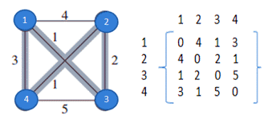
4. Is a good solution absolute or relative?
Problem characteristics
The Travelling Salesman Problem
We have to try all paths to find the shortest one.
Path: 1-2-3-4-1 Total cost = 14
Best Path Problem
Best Path: 1-3-2-4-1 Total cost = 7
Mr. Prayag Patel
Department: IT/ICT-LJIET

Slide 57
5. Is the solution a state or a path?
Problem characteristics
Finding a consistent interpretation
“The bank president ate a dish of pasta salad with the fork”.
“bank” refers to a financial situation or to a side of a river?
“dish” or “pasta salad” was eaten?
Does “pasta salad” contain pasta, as “dog food” does not contain “dog”?
Which part of the sentence does “with the fork” modify? What if “with vegetables” is there?
In this example, the solution is a state,
we need only the meaning of a sentence, not the way in which interpretation was found
Mr. Prayag Patel
Department: IT/ICT-LJIET

Slide 58
5. Is the solution a state or a path?
Problem characteristics
Water jug Problem
In water jug problem, it is not sufficient to report that we have solved, but the path that we found to the state (2, 0).
Thus the statement of a solution to this problem must be a sequence of operations that produces the final state.
Water Jug Problem is the solution as a path.
Mr. Prayag Patel
Department: IT/ICT-LJIET

Slide 59
6. What is the role of knowledge
Problem characteristics
Playing chess
Assumption: Suppose you have unlimited computing power available.
How much knowledge required:
A set of rules for determining legal moves.
Some simple control mechanism that implement an appropriate search procedure.
Good strategy and tactics could help to constraint the search and speed up search procedure.
A lot of knowledge required for searching
Mr. Prayag Patel
Department: IT/ICT-LJIET

Slide 60
6. What is the role of knowledge
Problem characteristics
Reading Newspaper
Problem of scanning daily newspaper to decide winner and percent of public supporting democratic and republican party in election.
Knowledge required:
The names of candidates in each party.
A lot of knowledge is required to recognize a solution
Mr. Prayag Patel
Department: IT/ICT-LJIET

Slide 61
7. Does the task require interaction with person?
Problem characteristics
It depends on problem, that task require interaction with person or not.
Solitary Problem in which the computer will be given a problem description and will produce an answer, with no intermediate communication.
  Example: Fact derivation from given statements.
Conversational Problem in which there will be intermediate communication between a person and the computer, Sometimes level of interaction increases in case of game playing.
  Example: Chess in which with each move human interaction is required.
Mr. Prayag Patel
Department: IT/ICT-LJIET

Slide 62
TYPES of Production System
Mr. Prayag Patel

Slide 63
Production System
Production system provides a structure, which is useful to arrange AI programs in a way that facilitates describing and performing search.
A production system consists of:
A set of rules, each consisting of a left side that determines the applicability of the rule and a right side that describes the operation to be performed if that rule is applied.
One or more knowledge/databases that contain whatever information is appropriate for the particular task. Some parts of the database may be permanent, while other parts of it may pertain only to the solution of the current problem.
A control strategy that specifies the order in which the rules will be compared to the database and a way of resolving the conflicts that arise when several rules match at once.
A rule applier which is the computational system that implements the control strategy and applies the rules.
Mr. Prayag Patel
Department: IT/ICT-LJIET

Slide 64
Types of Production System
Production System
Monotonic Production System: In a monotonic production system, the use of one rule never prevents the involvement of another rule when both the rules are selected at the same time. Hence, it enables the system to apply rules simultaneously.
Partially Commutative Production System: In this production system if a set of rules is used to change state A to state B then any allowable combination of these rules will also produce the same results (convert state A to state B).
Mr. Prayag Patel
Department: IT/ICT-LJIET

Slide 65
Types of Production System
Production System
Non-Monotonic Production System: This production system increases the problem-solving efficiency of the machine by not keeping a record of the changes made in the previous search process. These types of production systems are useful from an implementation point of view as they do not backtrack to the previous state when it is found that an incorrect path was followed. These are useful for solving ignorable problems.
Commutative Production System: These type of production systems is used when the order of operation is not important, and the changes are reversible.
Mr. Prayag Patel
Department: IT/ICT-LJIET

Slide 66
Issues in Design of search programs
Mr. Prayag Patel

Slide 67
Following are some issues:
Issues in Design of search programs
The direction in which to conduct the search either forward or backward.
  Forward-Initial state to Goal state
  Backward-Goal state to Initial state
How to select applicable rule matching.
  Generally production system spends most of their time for rules to apply.
How to represent each node of the search process.
  Knowledge representation problem and frame problem.
Search tree versus search graph
Mr. Prayag Patel
Department: IT/ICT-LJIET

Slide 68
Search tree versus search graph:
Issues in Design of search programs
Search tree
(0,0)
(4,3) (0,0) (1,3) (4,3) (0,0) (3,0)
(4,0)
(0,3)
Mr. Prayag Patel
Department: IT/ICT-LJIET

Slide 69
Search tree versus search graph:
Issues in Design of search programs
Search Graph
(0,0)
(4,0)
(0,3)
(1,3)
(4,3)
(3,0)
Mr. Prayag Patel
Department: IT/ICT-LJIET

Slide 70
Algorithm: Check duplicate Nodes
Issues in Design of search programs
Examine the set of nodes that have been created so far to see if the new node already exists.
It is does not, simply add it to the graph just as for a tree.
If it does already exist, then do the following:
(0,0)
(4,0)
Set the node that is being expanded to point to the already existing node corresponding to its successor.
If you are keeping track of the best path to each node, then check to see if the new path is better or worse than old one. If worse, do nothing. If better, record the new path as the correct path to use to get the node.
(1,3)
(4,3)
Mr. Prayag Patel
Department: IT/ICT-LJIET

Slide 71
Additional Problems
Mr. Prayag Patel

Slide 72
Additional Problems
Additional Problems
Missionaries and Cannibals problem
Tower of Hanoi problem
Monkey banana problem
Mr. Prayag Patel
Department: IT/ICT-LJIET

Slide 73
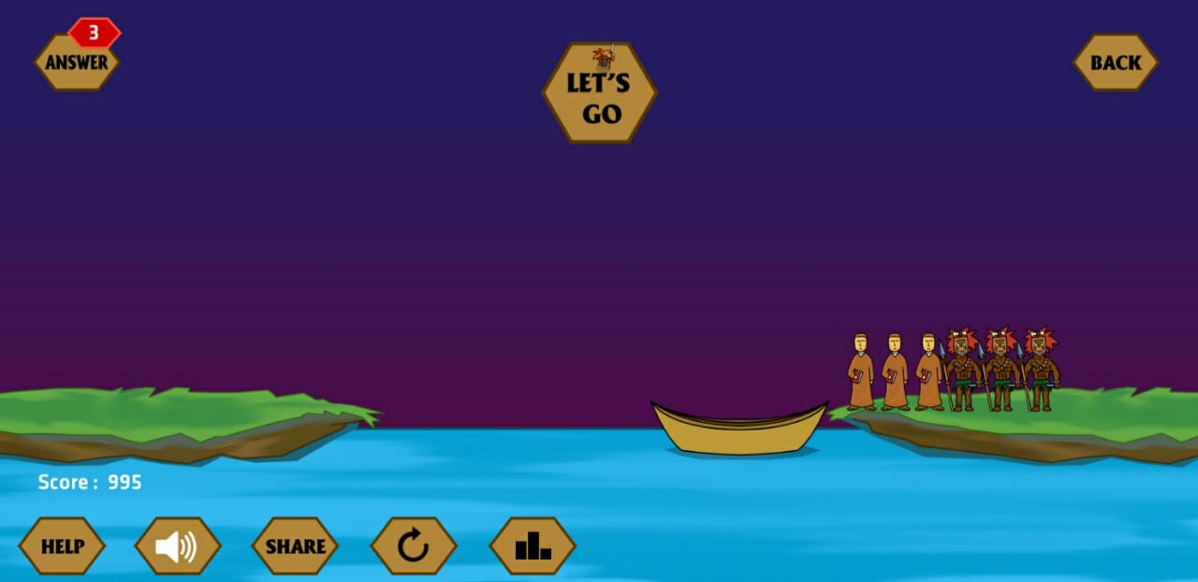
Additional Problems
Missionaries and Cannibals problem
Three missionaries and three cannibals find themselves on one side of river.
They all agreed to move on other side of river. But missionaries are not sure what the cannibals have agreed to.
So, missionaries want to manage the trip across the river in such a way that number of missionaries on either side of river is never less than number of cannibals.
Tower of Hanoi problem
No. of missionaries < No. of cannibals(Not allowed)
Mr. Prayag Patel
Department: IT/ICT-LJIET
Monkey banana problem

Slide 74
Missionaries and Cannibals problem
Mr. Prayag Patel
Department: IT/ICT-LJIET

Slide 75
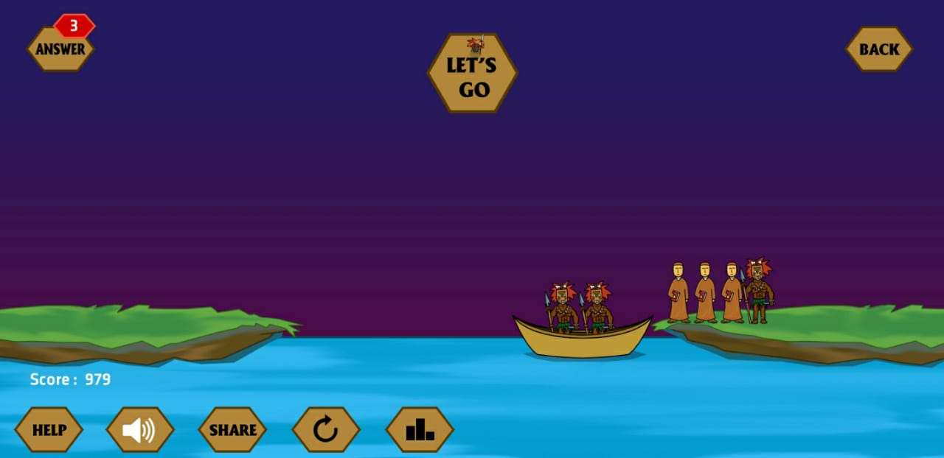
Missionaries and Cannibals problem
Mr. Prayag Patel
Department: IT/ICT-LJIET

Slide 76
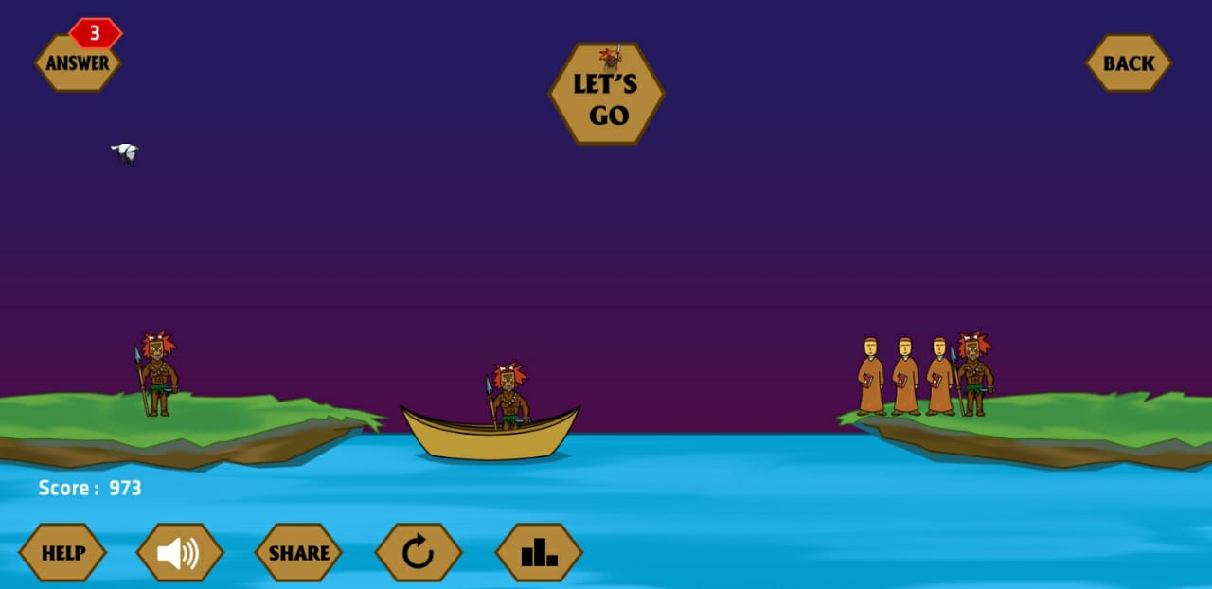
Missionaries and Cannibals problem
Mr. Prayag Patel
Department: IT/ICT-LJIET

Slide 77
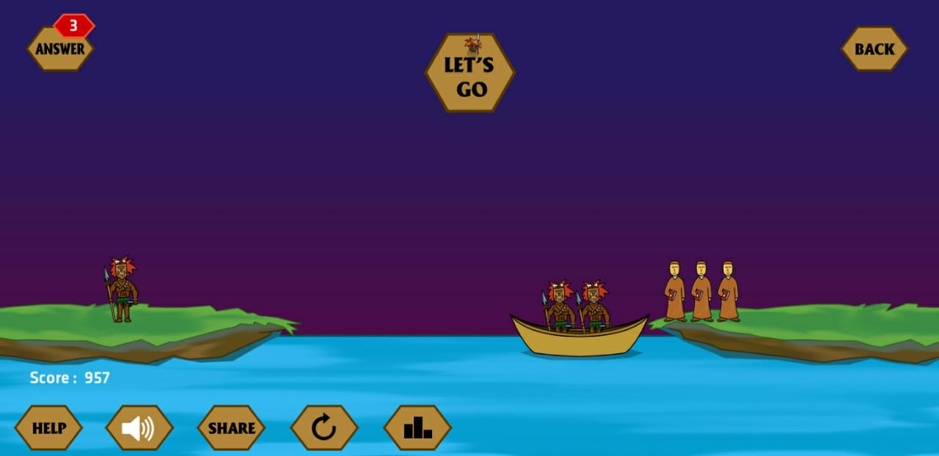
Missionaries and Cannibals problem
Mr. Prayag Patel
Department: IT/ICT-LJIET

Slide 78
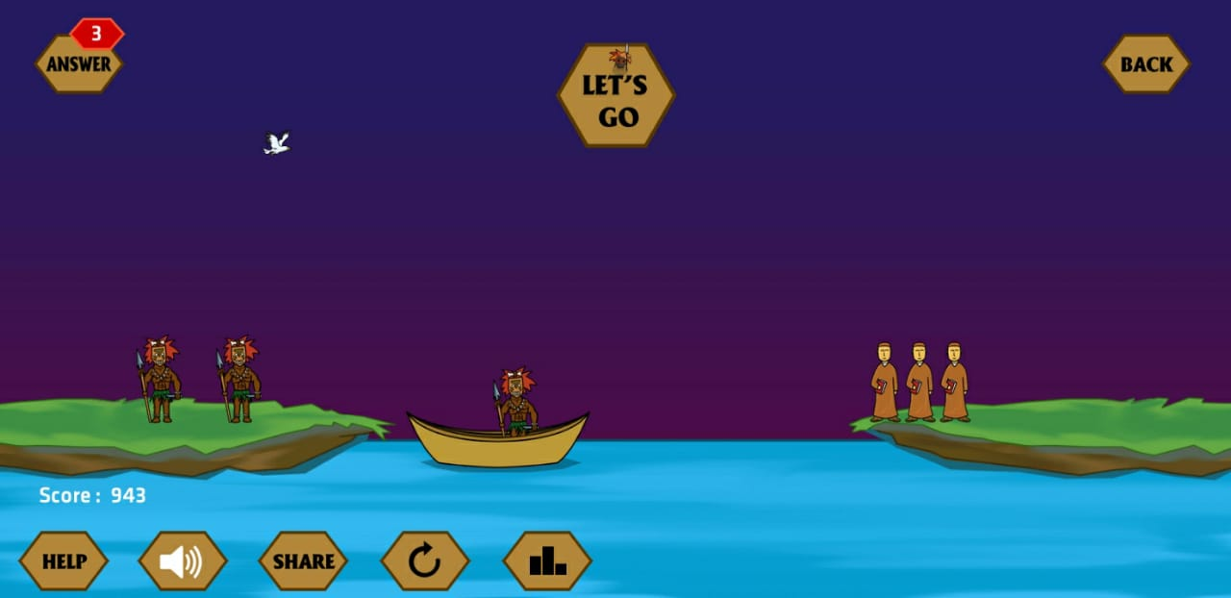
Missionaries and Cannibals problem
Mr. Prayag Patel
Department: IT/ICT-LJIET

Slide 79
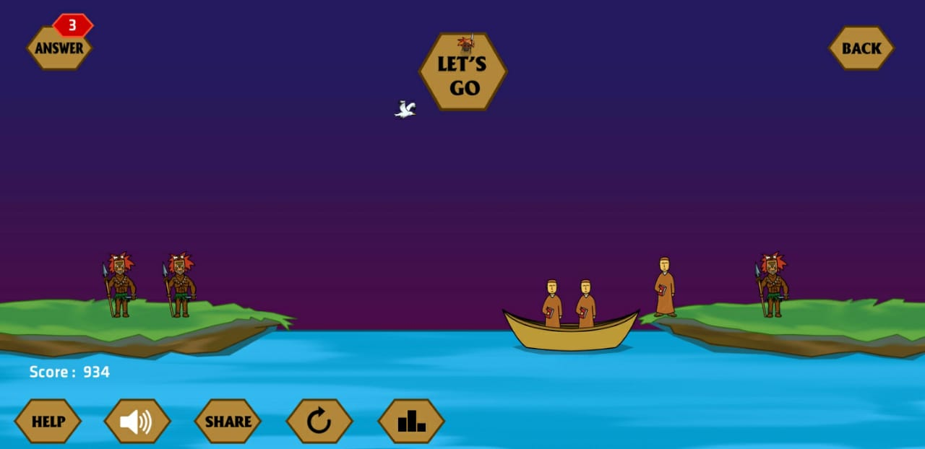
Missionaries and Cannibals problem
Mr. Prayag Patel
Department: IT/ICT-LJIET

Slide 80
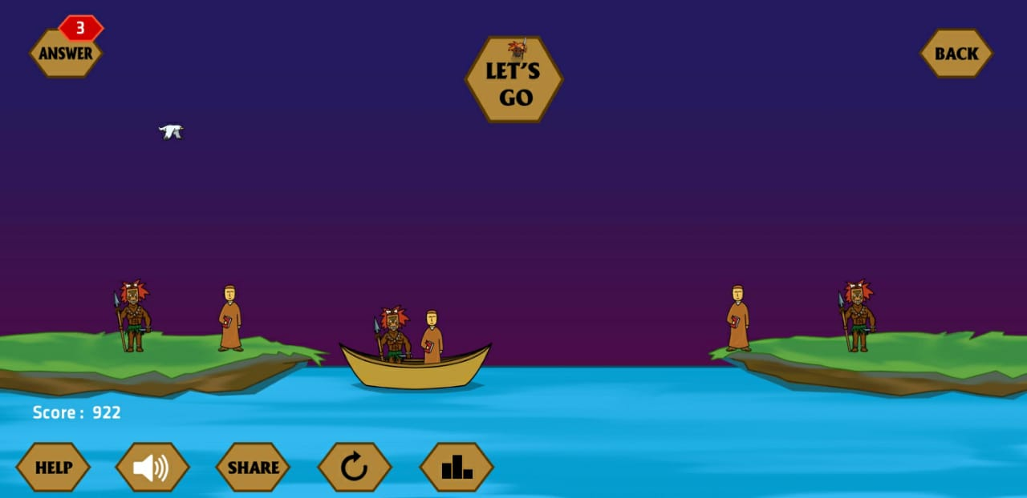
Missionaries and Cannibals problem
Mr. Prayag Patel
Department: IT/ICT-LJIET

Slide 81
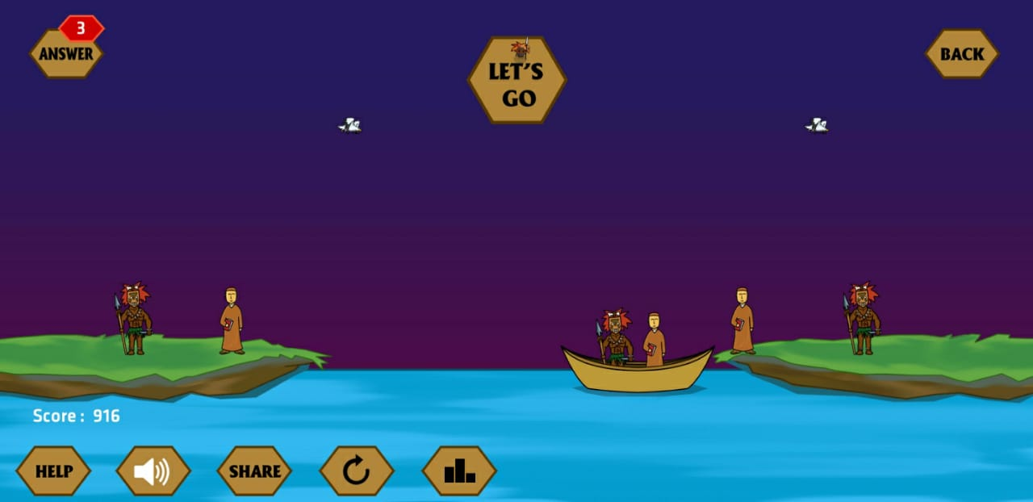
Missionaries and Cannibals problem
Mr. Prayag Patel
Department: IT/ICT-LJIET

Slide 82
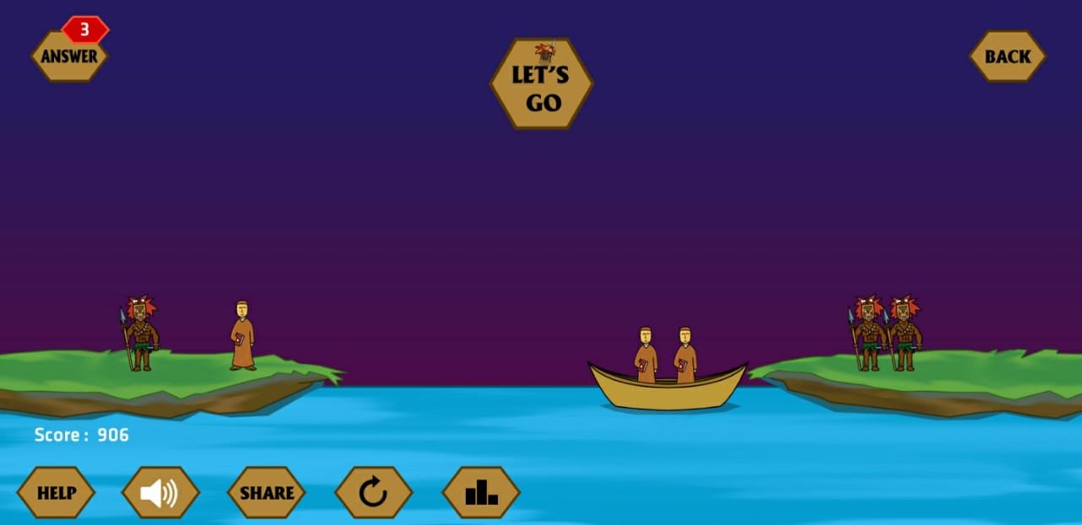
Missionaries and Cannibals problem
Mr. Prayag Patel
Department: IT/ICT-LJIET

Slide 83
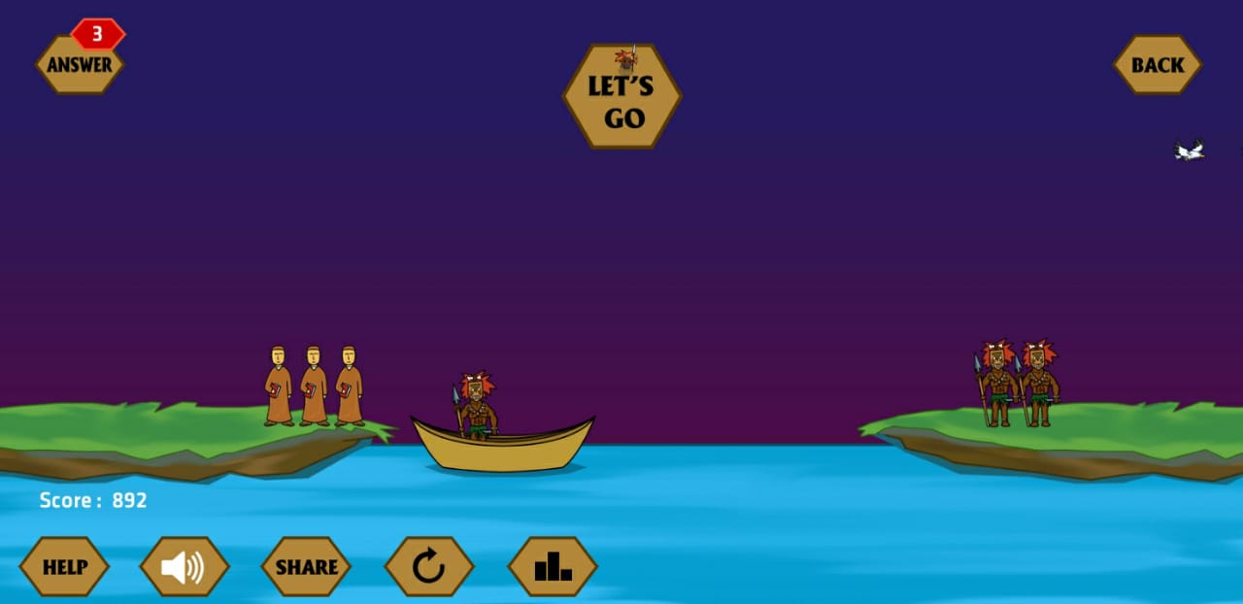
Missionaries and Cannibals problem
Mr. Prayag Patel
Department: IT/ICT-LJIET

Slide 84
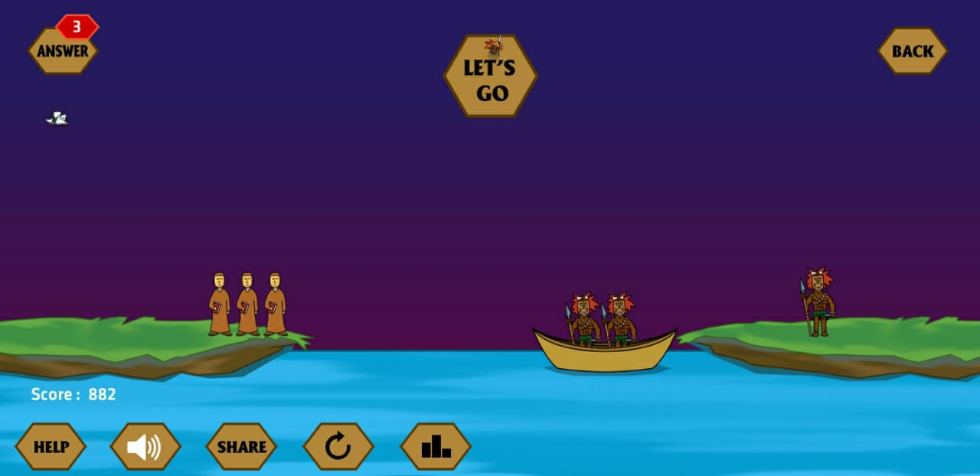
Missionaries and Cannibals problem
Mr. Prayag Patel
Department: IT/ICT-LJIET

Slide 85
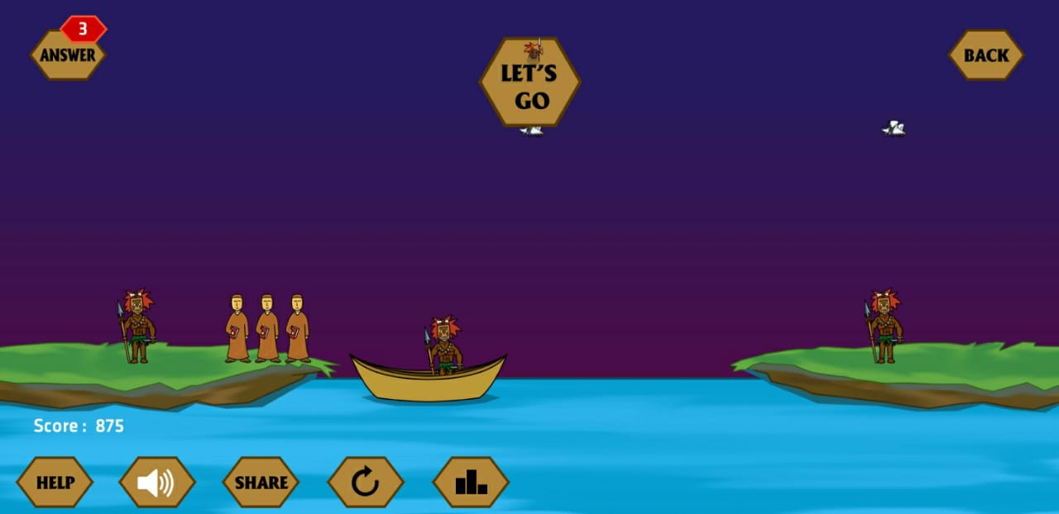
Missionaries and Cannibals problem
Mr. Prayag Patel
Department: IT/ICT-LJIET

Slide 86
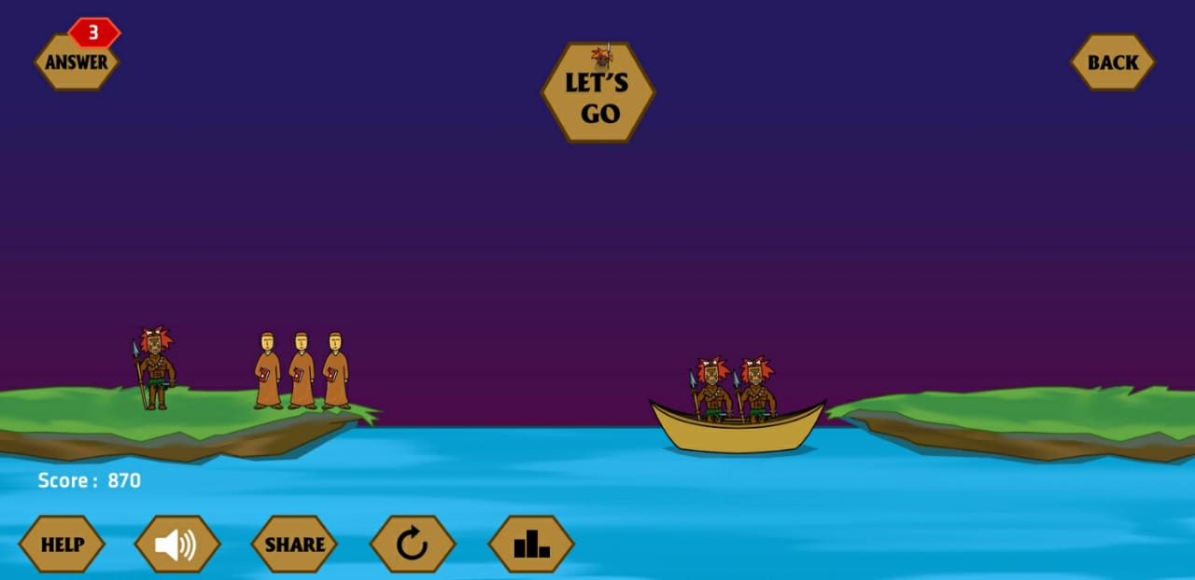
Missionaries and Cannibals problem
Mr. Prayag Patel
Department: IT/ICT-LJIET

Slide 87
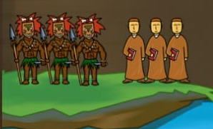
Additional Problems
Missionaries and Cannibals problem
Tower of Hanoi problem
Mr. Prayag Patel
Department: IT/ICT-LJIET
Monkey banana problem

Slide 88
Additional Problems
Additional Problems
Missionaries and Cannibals problem
Tower of Hanoi problem
Monkey banana problem
Mr. Prayag Patel
Department: IT/ICT-LJIET

Slide 89
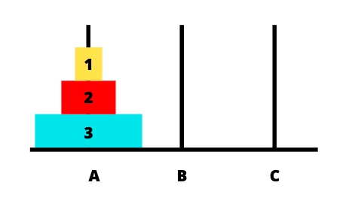
Additional Problems
Missionaries and Cannibals problem
Tower of Hanoi problem
Initially all the disks on one pole, each disk resting on the one just larger than it.
Move all the disk from one of the three poles to another.
Only one disk may be moved at a time and all other disk must be on one of the pole.
They could never place a large disk on top of a smaller one .
Third pole be used as a temporary resting place for the disks.
Starting state
Mr. Prayag Patel
Department: IT/ICT-LJIET
Monkey banana problem

Slide 90
Additional Problems
Missionaries and Cannibals problem
Tower of Hanoi problem
Starting state
Mr. Prayag Patel
Department: IT/ICT-LJIET
Monkey banana problem

Slide 91
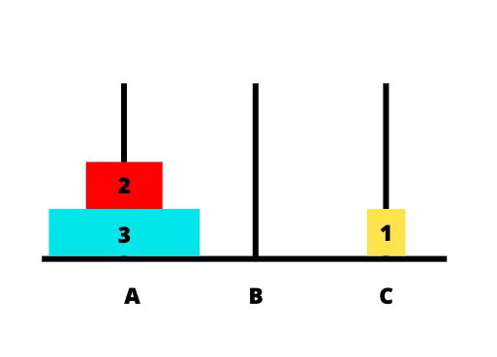
Additional Problems
Missionaries and Cannibals problem
Tower of Hanoi problem
Take disk 1 from pole A to pole C
Mr. Prayag Patel
Department: IT/ICT-LJIET
Monkey banana problem

Slide 92
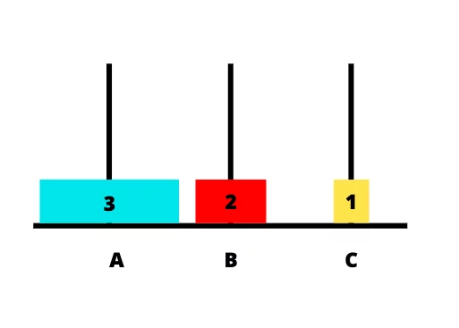
Additional Problems
Missionaries and Cannibals problem
Tower of Hanoi problem
Take disk 2 from pole A to pole B
Mr. Prayag Patel
Department: IT/ICT-LJIET
Monkey banana problem

Slide 93
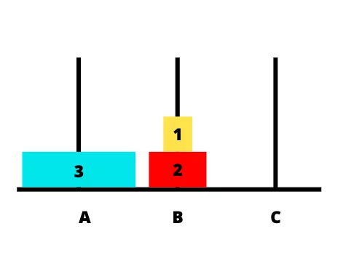
Additional Problems
Missionaries and Cannibals problem
Tower of Hanoi problem
Take disk 1 from pole C to pole B
Mr. Prayag Patel
Department: IT/ICT-LJIET
Monkey banana problem

Slide 94
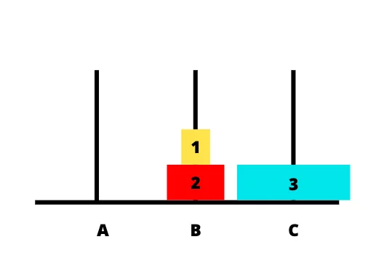
Additional Problems
Missionaries and Cannibals problem
Tower of Hanoi problem
Take disk 3 from pole A to pole C
Mr. Prayag Patel
Department: IT/ICT-LJIET
Monkey banana problem

Slide 95
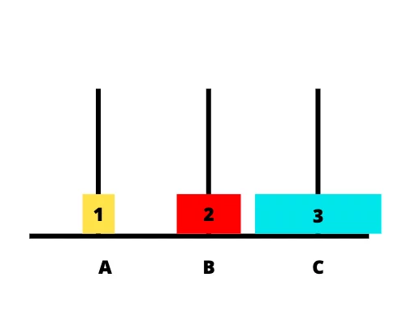
Additional Problems
Missionaries and Cannibals problem
Tower of Hanoi problem
Take disk 1 from pole B to pole A
Mr. Prayag Patel
Department: IT/ICT-LJIET
Monkey banana problem

Slide 96
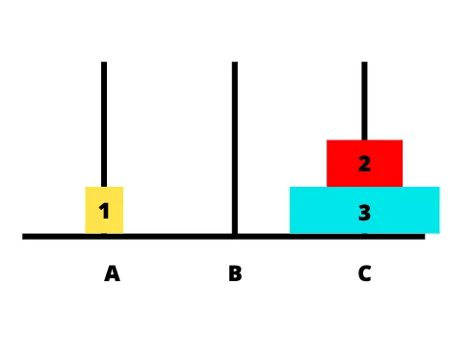
Additional Problems
Missionaries and Cannibals problem
Tower of Hanoi problem
Take disk 2 from pole B to pole C
Mr. Prayag Patel
Department: IT/ICT-LJIET
Monkey banana problem

Slide 97
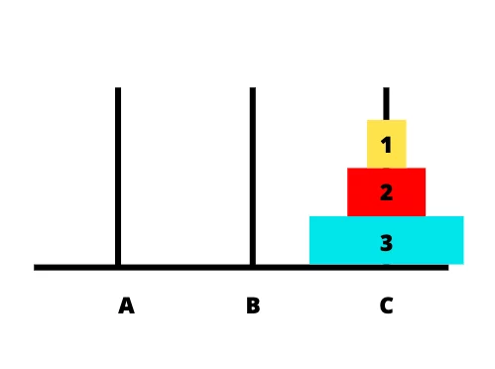
Additional Problems
Missionaries and Cannibals problem
Tower of Hanoi problem
Take disk 1 from pole A to pole C
Mr. Prayag Patel
Department: IT/ICT-LJIET
Monkey banana problem

Slide 98
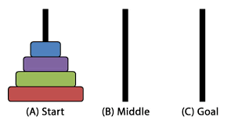
Additional Problems
Missionaries and Cannibals problem
Tower of Hanoi problem
4 Disk
Mr. Prayag Patel
Department: IT/ICT-LJIET
Monkey banana problem

Slide 99
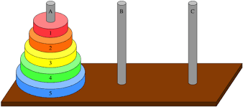
Additional Problems
Missionaries and Cannibals problem
Tower of Hanoi problem
5 Disk
Mr. Prayag Patel
Department: IT/ICT-LJIET
Monkey banana problem

Slide 100
Additional Problems
Additional Problems
Missionaries and Cannibals problem
Tower of Hanoi problem
Monkey banana problem
Mr. Prayag Patel
Department: IT/ICT-LJIET

Slide 101
Additional Problems
Missionaries and Cannibals problem
Tower of Hanoi problem
Monkey banana problem
A hungry monkey finds himself in a room in which a Banana is hanging from ceiling.
A monkey unfortunately cannot reach the bananas. So, there’s also a chair and a stick.
The ceiling is just the right height so that a monkey standing on a chair could knock the banana down with the stick.
What is the best sequence of actions for monkey to take to acquire lunch?
Mr. Prayag Patel
Department: IT/ICT-LJIET

Slide 102
Additional Problems
Missionaries and Cannibals problem
Tower of Hanoi problem
Monkey banana problem
Solution:
Initial state: Monkey on ground with empty hand.
Goal state: Monkey eating.
Actions: Climb chair/Get off, Grab X, Wave X, Eat X
Mr. Prayag Patel
Department: IT/ICT-LJIET

Slide 103

Additional Problems
Missionaries and Cannibals problem
Tower of Hanoi problem
Monkey banana problem
Monkey on Ground with empty Hands
Climb chair
Grab Stick
Monkey on chair with empty Hands
Monkey on Ground with Stick
Drop stick
Get off chair
Climb chair
Monkey on chair with stick
Monkey on Ground with empty Hands
Wave stick
Monkey on chair with stick and Banana falls to Ground
Get off chair
Monkey on Ground with stick
Drop stick
Grab Banana
Monkey on Ground with Banana
Eat Banana
Monkey eating Banana
Department: IT/ICT-LJIET
Mr. Prayag Patel

Slide 104
Heuristic search technique
Mr. Prayag Patel

Slide 105
Search Strategies
Two types:
1. Uninformed search (blind search)
Having no information about the number of steps from the current state to the goal. (BFS, DFS)
2. Informed search (heuristic search)
More efficient than uninformed search.
Mr. Prayag Patel
Department: IT/ICT-LJIET

Slide 106
Search Strategies
Uninformed search
(blind search)
Depth-first Search
Breadth-first Search
Generate-and-test
Hill Climbing
  Simple Hill Climbing
  Steepest – Ascent Hill Climbing
  Simulated Annealing
Best – First Search
  OR Graph
  A* Algorithm
Problem Reduction
  AND-OR Graph
  AO* Algorithm
Constraint Satisfaction
Means- End Analysis
informed search
(Heuristic search)
Mr. Prayag Patel
Department: IT/ICT-LJIET

Slide 107
Heuristic Search Techniques
Heuristic is a method that might not always find the best solution but is certain to find a good solution in a reasonable time.
Heuristic is a technique that improves the efficiency of a search process, possibly by sacrificing claims of completeness.
Well-designed heuristic functions can play an important part in efficiently guiding a search process toward a solution.
Mr. Prayag Patel
Department: IT/ICT-LJIET

Slide 108
Heuristic Search Techniques
The heuristic function is a way to inform the search about the direction to a goal. It provides an informed way to guess which neighbor of a node will lead to a goal.
Heuristic Function is a function that estimates the cost of getting from one place to another (from the current state to the goal state.) Also called as simply a heuristic.
Used in a decision process to try to make the best choice of a list of possibilities (to choose the move more likely to lead to the goal state.) Best move is the one with the least cost.
Mr. Prayag Patel
Department: IT/ICT-LJIET

Slide 109
Heuristic Search Technique
Generate-and-test
Hill Climbing
  Simple Hill Climbing
  Steepest – Ascent Hill Climbing
  Simulated Annealing
Best – First Search
  OR Graph
  A* Algorithm
Problem Reduction
  AND-OR Graph
  AO* Algorithm
Constraint Satisfaction
Means- End Analysis
Mr. Prayag Patel
Department: IT/ICT-LJIET

Slide 110
Generate-and-test
Generate-and-test search algorithm is a very simple algorithm that guarantees to find a solution if done systematically and there exists a solution.
Algorithm:
Generate a possible solution. For some problems, this means generating a particular point in the problem space. For others it means generating a path from a start stat.
Test to see if this is actually a solution by comparing the chosen point or the endpoint of the chosen path to the set of acceptable goal states.
If a solution has been found, quit, Otherwise return to step 1.
Mr. Prayag Patel
Department: IT/ICT-LJIET

Slide 111
Generate-and-test
This algorithm works in following manner:
Generator module: It is used to create the possible solution.
Tester module: It tests each of the proposed solution either accepting or rejecting solution.
Mr. Prayag Patel
Department: IT/ICT-LJIET

Slide 112
Generate-and-test
Three form of Generate-and-test
Systematic Form: It is simply an exhaustive search of the problem space.(all possibilities)
Pure Randomly: Solution can generated randomly but solution is not guaranteed.
Practical Approach: Search process systematically but not consider paths that seem unlikely to lead to a solution. This evolution is performed by heuristic function.
Mr. Prayag Patel
Department: IT/ICT-LJIET

Slide 113
Generate-and-test
Acceptable for simple problems.
Inefficient for problems with large space.
It is a depth first search procedure since complete solutions must be generated before they can be tested.
In Generate and test procedure, the test function responds with only a Yes or No.
Mr. Prayag Patel
Department: IT/ICT-LJIET

Slide 114
Generate-and-test
Example: The Travelling Salesman Problem
Path: 1-2-3-4-1 Total cost = 14
Path: 1-2-4-3-1 Total cost = 11
Path: 1-4-3-2-1 Total cost = 14
Path: 1-3-4-2-1 Total cost = 11
.
.
.
Best Path: 1-3-2-4-1 Total cost = 7
Mr. Prayag Patel
Department: IT/ICT-LJIET

Slide 115
Heuristic Search Techniques
Hill Climbing
Mr. Prayag Patel

Slide 116
Heuristic Search Technique
Generate-and-test
Hill Climbing
  Simple Hill Climbing
  Steepest – Ascent Hill Climbing
  Simulated Annealing
Best – First Search
  OR Graph
  A* Algorithm
Problem Reduction
  AND-OR Graph
  AO* Algorithm
Constraint Satisfaction
Means- End Analysis
Mr. Prayag Patel
Department: IT/ICT-LJIET

Slide 117
Hill Climbing
Hill climbing is a variant of generate and test in which feedback from the test procedure is used to help the generator device which direction to move in the search space.
In Generate and test procedure, the test function responds with only a Yes or No.
Hill Climbing = Generate-and-test + direction to move.
Heuristic function to estimate how close a given state is to a goal state.
A search method of selecting the best local choice at each step in hopes of finding an optimal solution.
Hill climbing is often used when a good heuristic function is available for evaluating states but when no other useful knowledge is available.
Mr. Prayag Patel
Department: IT/ICT-LJIET

Slide 118
Hill Climbing
Hill Climbing
Simple Hill Climbing
Steepest – Ascent Hill Climbing
Simulated Annealing
Mr. Prayag Patel
Department: IT/ICT-LJIET

Slide 119
Hill Climbing
Simple Hill Climbing
Algorithm:
Evaluate the initial state. If it is also a goal state then return it and quit. Otherwise continue with initial state as the current state.
Loop until a solution is found or until there are no new operators left to be applied in the current state.
Select an operator that has not yet been applied to current state and apply it to produce a new state.
Evaluate new state.
    If it is goal state, then return and quit.
    If it is not a goal state, but it is better than current state then make it current state.
    If it is not better than current state, then continue in loop.
Steepest – Ascent Hill Climbing
Mr. Prayag Patel
Department: IT/ICT-LJIET
Simulated Annealing

Slide 120
Hill Climbing
Hill Climbing
Simple Hill Climbing
Steepest – Ascent Hill Climbing
Simulated Annealing
Mr. Prayag Patel
Department: IT/ICT-LJIET

Slide 121
Hill Climbing
Simple Hill Climbing
Steepest – Ascent Hill Climbing
In Generate and test procedure, the test function responds with only a Yes or No.
In Simple hill climbing we check the new state is batter than the current state? (Not Considers all the moves from the current state.)
In Steepest – Ascent hill climbing Considers all the moves from the current state.
Selects the best one as the next state.
Mr. Prayag Patel
Department: IT/ICT-LJIET
Simulated Annealing

Slide 122
Hill Climbing
Simple Hill Climbing
Steepest – Ascent Hill Climbing
Algorithm:
Evaluate the initial state. If it is also a goal state, then return and quit. Otherwise, continue with initial state as the current state.
Loop until a solution is found or a complete iteration produces no change to current state:
  Let SUCC be a state such that any possible successor of the current state will be better than SUCC.
Mr. Prayag Patel
Department: IT/ICT-LJIET
Simulated Annealing

Slide 123
Hill Climbing
Simple Hill Climbing
Steepest – Ascent Hill Climbing
b) For each operator that applies to the current state do:
i) Apply operator and generate new state.
ii) Evaluate new state. If it is a goal state, then return it and quit. If not, compare it to SUCC. If it is better, then set SUCC to this state. If it is not better, leave SUCC alone.
c) If the SUCC is better than current state, then set current state to SUCC.
Mr. Prayag Patel
Department: IT/ICT-LJIET
Simulated Annealing

Slide 124
Hill Climbing
Simple Hill Climbing
Steepest – Ascent Hill Climbing
Example: 8-Puzzle
Initial state:
Goal state:
2 | 8 | 3
1 | 6 | 4
7 |  | 5
1 | 2 | 3
8 |  | 4
7 | 6 | 5
Mr. Prayag Patel
Department: IT/ICT-LJIET
Simulated Annealing

Slide 125
Hill Climbing
Simple Hill Climbing
Steepest – Ascent Hill Climbing
Example: 8-Puzzle
Goal state
2 | 8 | 3
1 | 6 | 4
7 |  | 5
1 | 2 | 3
8 |  | 4
7 | 6 | 5
4
2 | 8 | 3
1 | 6 | 4
 | 7 | 5
2 | 8 | 3
1 |  | 4
7 | 6 | 5
2 | 8 | 3
1 | 6 | 4
7 | 5
5
3
5
F(n) = Number of tiles out of place
Mr. Prayag Patel
Department: IT/ICT-LJIET
Simulated Annealing

Slide 126
Hill Climbing
Simple Hill Climbing
Drawbacks of Hill Climbing
Both the Simple and steepest ascent hill climbing may fail to find a solution because of no better state is available.
Three well known Drawbacks:
Local Maximum
Plateau
Ridge
Mr. Prayag Patel
Department: IT/ICT-LJIET
Simulated Annealing

Slide 127
Hill Climbing
Simple Hill Climbing
Drawbacks of Hill Climbing
Three well known Drawbacks:
Local Maximum
A state which is better than all its neighbors but not better than some farther away.
local maximum
Mr. Prayag Patel
Department: IT/ICT-LJIET
Simulated Annealing

Slide 128
Hill Climbing
Simple Hill Climbing
Drawbacks of Hill Climbing
Three well known Drawbacks:
Plateau
It is a flat area of the search space in which a whole set of neighboring states have same value.
Plateau
Mr. Prayag Patel
Department: IT/ICT-LJIET
Simulated Annealing

Slide 129
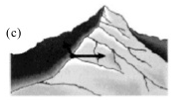
Hill Climbing
Simple Hill Climbing
Drawbacks of Hill Climbing
Three well known Drawbacks:
Ridge
It is a special type of local maximum. It is an area of search space that is higher than surrounding are that itself has a slope.
Where search direction is not towards the top but towards the side.
Ridge
Mr. Prayag Patel
Department: IT/ICT-LJIET
Simulated Annealing

Slide 130
Hill Climbing
Simple Hill Climbing
Drawbacks of Hill Climbing
Solution:
Local Maximum
Backtrack to some earlier node and try going in a different direction.
Global maximum
local maximum
Mr. Prayag Patel
Department: IT/ICT-LJIET
Simulated Annealing

Slide 131
Hill Climbing
Simple Hill Climbing
Drawbacks of Hill Climbing
Solution:
Plateau
Make a big jump to try to get in a new section.
Plateau
Mr. Prayag Patel
Department: IT/ICT-LJIET
Simulated Annealing

Slide 132
Hill Climbing
Simple Hill Climbing
Drawbacks of Hill Climbing
Solution:
Ridge
Apply two or more rules before doing the test.
Moving in several directions at once.
Ridge
Mr. Prayag Patel
Department: IT/ICT-LJIET
Simulated Annealing

Slide 133
Hill Climbing
Simple Hill Climbing
Hill Climbing
Example: Block world Problem Using Hill Climbing Technique.
Start
Goal
A
D
D
C
C
B
B
A
Blocks World
Operators:
Pickup one block and put it on the table.
Pickup one block and put it on another one.
Mr. Prayag Patel
Department: IT/ICT-LJIET
Simulated Annealing

Slide 134
Hill Climbing
Simple Hill Climbing
Hill Climbing
Example: Block world Problem Using Hill Climbing Technique.
Start
Goal
0
A
-1
4
D
+1
D
+1
C
+1
C
+1
B
+1
B
-1
A
+1
Blocks World
Local heuristic:
+1 for each block that is resting on the thing it is supposed to be resting on.
-1 for each block that is resting on a wrong thing.
Mr. Prayag Patel
Department: IT/ICT-LJIET
Simulated Annealing

Slide 135
Hill Climbing
Simple Hill Climbing
Hill Climbing
Example: Block world Problem Using Hill Climbing Technique.
Goal
4
D
0
A
-1
C
D
+1
B
C
+1
A
B
-1
2
D
+1
C
+1
B
-1
A
+1
Mr. Prayag Patel
Department: IT/ICT-LJIET
Simulated Annealing

Slide 136
Hill Climbing
Simple Hill Climbing
Hill Climbing
Example: Block world Problem Using Hill Climbing Technique.
Goal
2
D
4
D
C
C
0
B
A
B
A
-1
A
D
+1
0
0
C
+1
C
+1
D
-1
C
+1
B
-1
B
-1
A
+1
B
-1
A
+1
D
-1
Hill climbing will halt because all these states have lower scores than the current state.
Mr. Prayag Patel
Department: IT/ICT-LJIET
Simulated Annealing

Slide 137
Hill Climbing
Simple Hill Climbing
Hill Climbing
Example: Block world Problem Using Hill Climbing Technique.
Start
Goal
-6
A
-3
6
D
+3
D
-2
C
+2
C
-1
B
+1
B
0
A
0
Blocks World
Global heuristic:
For each block that has the correct support structure:
+ 1 to every block in the support structure.
For each block that has a wrong support structure:
- 1 to every block in the support structure.
Mr. Prayag Patel
Department: IT/ICT-LJIET
Simulated Annealing

Slide 138
Hill Climbing
Simple Hill Climbing
Hill Climbing
Example: Block world Problem Using Hill Climbing Technique.
Goal
6
D
C
B
-6
A
-3
A
- 3
D
-2
D
-2
C
-1
C
-1
B
0
B
0
A
0
Mr. Prayag Patel
Department: IT/ICT-LJIET
Simulated Annealing

Slide 139
Hill Climbing
Simple Hill Climbing
Hill Climbing
Example: Block world Problem Using Hill Climbing Technique.
Goal
-3
D
6
D
C
C
B
A
B
A
- 6
A
-3
- 2
D
-2
- 1
C
-1
C
-1
D
-1
C
-1
B
0
B
0
A
0
B
0
A
0
D
0
Mr. Prayag Patel
Department: IT/ICT-LJIET
Simulated Annealing

Slide 140
Hill Climbing
Simple Hill Climbing
Hill Climbing
Example: Block world Problem Using Hill Climbing Technique.
Goal
- 1
C
-1
6
D
B
0
A
0
D
0
C
B
A
+ 1
0
B
+1
C
0
B
0
A
0
D
0
C
0
A
0
D
0
Mr. Prayag Patel
Department: IT/ICT-LJIET
Simulated Annealing

Slide 141
Hill Climbing
Simple Hill Climbing
Hill Climbing
Example: Block world Problem Using Hill Climbing Technique.
Goal
B
+1
6
D
C
0
A
0
D
0
C
B
+ 6
A
D
+3
+ 3
C
+2
C
+2
B
+1
B
+1
A
0
D
0
A
0
Mr. Prayag Patel
Department: IT/ICT-LJIET
Simulated Annealing

Slide 142
Hill Climbing
Hill Climbing
Simple Hill Climbing
Steepest – Ascent Hill Climbing
Simulated Annealing
Mr. Prayag Patel
Department: IT/ICT-LJIET

Slide 143
Hill Climbing
Simple Hill Climbing
Steepest – Ascent Hill Climbing
Simulated Annealing
A variation of hill climbing in which, at the beginning of the process, some downhill moves may be made.
To do enough exploration of the whole space early on, so that the final solution is relatively insensitive to the starting state.
Lowering the chances of getting caught at a local maximum, or plateau, or a ridge.
Mr. Prayag Patel
Department: IT/ICT-LJIET

Slide 144
Hill Climbing
Simple Hill Climbing
Steepest – Ascent Hill Climbing
Simulated Annealing
Two change in simulated Annealing:
Use the term “Objective function” in place the “Heuristic Function”.
We attempt to minimize rather than maximize the value of the objective function.
Thus we actually describe a process of valley descending rather than Hill climbing.
Simulated annealing as a computational process is patterned after the physical process of annealing.
Mr. Prayag Patel
Department: IT/ICT-LJIET

Slide 145
Hill Climbing
Simple Hill Climbing
Steepest – Ascent Hill Climbing
Simulated Annealing
Physical Annealing
Physical substances are melted and then gradually cooled until some solid state is reached.
The goal is to produce a minimal-energy state.
Annealing schedule: if the temperature is lowered sufficiently slowly, then the goal will be attained.
But, there is some probability for a transition to a higher energy state: p = e^{-ΔE/kT}.
ΔE = change in energy
T = Temperature
k = constant
Mr. Prayag Patel
Department: IT/ICT-LJIET

Slide 146
Hill Climbing
Simple Hill Climbing
Steepest – Ascent Hill Climbing
Simulated Annealing
Algorithm
Evaluate the initial state. If it is also a goal state, then return and quit. Otherwise, continue with initial state as the current state.
Initialize BEST SO FAR to the current state.
Initialize T according to an annealing schedule.
Loop until a solution is found or there are no new operators left to be applied:
(a) Select an operator that has not yet been applied to current state and apply it to produce a new state.
Mr. Prayag Patel
Department: IT/ICT-LJIET

Slide 147
Hill Climbing
Simple Hill Climbing
Steepest – Ascent Hill Climbing
Simulated Annealing
(b) Evaluate the new state: ΔE = Val(current state) - Val(new state)
(i) If it is goal state, then return and quit. (goal → quit)
(ii) If it is not a goal state, but it is better than current state then
make it current state. Also set BEST SO FAR to this state.
(ΔE < 0 → new current state)
(iii) If it is not better than current state then make it current
state with probability e^{-ΔE/kT}.
(new current state with probability e^{-ΔE/kT}.)
(c) Revised T as necessary according to the annealing schedule.
5. Return BEST SO FAR, as the Answer.
Mr. Prayag Patel
Department: IT/ICT-LJIET

Slide 148
Hill Climbing
Simple Hill Climbing
Steepest – Ascent Hill Climbing
Simulated Annealing
Simulated annealing is often used to solve problems in which the number of moves from a given state is very large.
Mr. Prayag Patel
Department: IT/ICT-LJIET

Slide 149
Heuristic Search Technique
Generate-and-test
Hill Climbing
  Simple Hill Climbing
  Steepest – Ascent Hill Climbing
  Simulated Annealing
Best – First Search
  OR Graph
  A* Algorithm
Problem Reduction
  AND-OR Graph
  AO* Algorithm
Constraint Satisfaction
Means- End Analysis
Mr. Prayag Patel
Department: IT/ICT-LJIET

Slide 150
Hill Climbing
Simple Hill Climbing
Steepest – Ascent Hill Climbing
Best First Search
Best First Search is a way of combining the advantages of both DFS and BFS into a single method.
BFS is good because it does not get trapped on dead ends.
DFS is good because it allows solution to be found without all competing branches having to be expanded.
Using Best First Search, we select most promising of the nodes we have generated so far using heuristic function.
Mr. Prayag Patel
Department: IT/ICT-LJIET

Slide 151
Hill Climbing
Simple Hill Climbing
Steepest – Ascent Hill Climbing
Best First Search
OR Graphs
Here all the nodes will be connected by OR edge, i.e. we can traverse any of the node from all connected nodes by OR.
To implement OR graphs search procedure, we need to use two list of nodes.
OPEN: It contains the nodes that have been generated and heuristic function applied to them but which have not yet been expanded. This is organized as a priority queue.
CLOSED: It contains nodes that have been expanded.
Mr. Prayag Patel
Department: IT/ICT-LJIET

Slide 152
Best First Search
A
A
A
A
Step 1
B
C
D
B
C
D
B
C
D
3
5
1
3
5
5
E
F
G
H
E
F
Step 2
4
6
6
5
4
6
Step 3
Step 4
A
Step | OPEN | CLOSE
Step 1 | A | ---
Step 2 | B, C, D | A
Step 3 | B, C, E, F | A, D
Step 4 | C, E, F, G, H | A, B, D
Step 5 | C, F, G, H, I, J | A, B, D, E
B
C
D
5
G
H
E
F
6
5
6
I
J
2
1
Step 5
Mr. Prayag Patel
Department: IT/ICT-LJIET

Slide 153
Best First Search
A heuristic function f’ = g + h’.
Where
f’ = Estimated cost from initial state to goal state.
g = Cost of getting from initial state to current state.
h’ = Estimate of additional cost of getting from
current node to a goal state.
Mr. Prayag Patel
Department: IT/ICT-LJIET

Slide 154
Best First Search
Algorithm
Start with OPEN containing just the Initial stat. OPEN = {initial state}.
Loop until a goal is found or there are no nodes left in OPEN do:
(a) Pick the best node in OPEN
(b) Generate its successors.
(c) For each successor do:
(I) If it has not been generated before, evaluate it, add it to OPEN,
and record its parent. (new → evaluate it, add it to OPEN, record its parent)
(II) If it has been generated before, change the parent if this new path
is better than the previous one. In that case, update the cost of
getting to this node and to any successor that this node may
already have. (generated before → change parent, update successors)
Mr. Prayag Patel
Department: IT/ICT-LJIET

Slide 155
Best First Search
A* Algorithm
Start with OPEN containing only the initial node. Set node g = 0 and f’= 0 + h’ = h’. Set CLOSED to empty list.
Until a goal node is found, repeat following procedure. If OPEN is empty, stop and return failure. Otherwise, pick the node on OPEN with lowest f’ value. Call it BESTNODE. Remove it from OPEN and put it on CLOSED.
If BESTNODE is a goal, then return success & stop.
Otherwise generate the successor of BESTNODE, For each SUCCESSOR do the following:
(a) Set SUCCESSOR to point back to BESTNODE.
Mr. Prayag Patel
Department: IT/ICT-LJIET

Slide 156
Best First Search
(b)Compute g(SUCCESSOR)=g(BESTNODE) + the cost of getting from BESTNODE to successor.
(c)If SUCCESSOR is the same as any node on OPEN, call that node OLD, and add OLD to BESTNODE’S Successor. Check g(OLD) and g(SUCCESSOR). If g(SUCCESSOR) is cheaper then reset OLD’S Parent link to point to BESTNODE. Update g(OLD) and f’(OLD).
(d)If SUCCESSOR was not on OPEN, see if it is on CLOSED. If so call the node CLOSED OLD, and better as earlier and set the Parent link and g and f’ values appropriately.
(e)If SUCCESSOR was not already on earlier OPEN or CLOSED, then put it on OPEN and add it to the list of BESNODE’S Successors. Compute f’(SUCCESSOR) = g(SUCCESSOR) + h’(SUCCESSOR).
Mr. Prayag Patel
Department: IT/ICT-LJIET

Slide 157
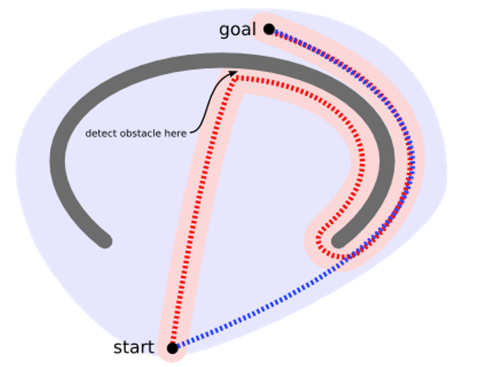
Best First Search
A* Algorithm
Mr. Prayag Patel
Department: IT/ICT-LJIET

Slide 158
Best First Search
A* Algorithm Example 8 Puzzle
Initial state:
Goal state:
2 | 8 | 3
1 | 6 | 4
7 |  | 5
1 | 2 | 3
8 |  | 4
7 | 6 | 5
H₁‘ = Number of tiles out of place with respect to goal state.
Mr. Prayag Patel
Department: IT/ICT-LJIET

Slide 159
Best First Search
A* Algorithm Example 8 Puzzle
Goal state
H₁‘ = Number of tiles out of place
f’ = g + h’
= 0 + 4
2 | 8 | 3
1 | 6 | 4
7 |  | 5
1 | 2 | 3
8 |  | 4
7 | 6 | 5
2 | 8 | 3
1 | 6 | 4
 | 7 | 5
2 | 8 | 3
1 |  | 4
7 | 6 | 5
2 | 8 | 3
1 | 6 | 4
7 | 5
f’ = g + h’
= 1 + 5
1 + 3
1 + 5
2 | 8 | 3
 | 1 | 4
7 | 6 | 5
2 |  | 3
1 | 8 | 4
7 | 6 | 5
2 | 8 | 3
1 | 4
7 | 6 | 5
2 + 3
2 + 3
2 + 4
Mr. Prayag Patel
Department: IT/ICT-LJIET

Slide 160
Best First Search
A* Algorithm Example 8 Puzzle
H₁‘ = Number of tiles out of place
f’ = g + h’
= 0 + 4
2 | 8 | 3
1 | 6 | 4
7 |  | 5
Goal state
1 | 2 | 3
8 |  | 4
7 | 6 | 5
2 | 8 | 3
1 | 6 | 4
 | 7 | 5
2 | 8 | 3
1 |  | 4
7 | 6 | 5
2 | 8 | 3
1 | 6 | 4
7 | 5
1 + 5
1 + 3
1 + 5
2 | 8 | 3
 | 1 | 4
7 | 6 | 5
2 |  | 3
1 | 8 | 4
7 | 6 | 5
2 | 8 | 3
1 | 4
7 | 6 | 5
2 + 3
2 + 3
2 + 4
 | 8 | 3
2 | 1 | 4
7 | 6 | 5
2 | 8 | 3
7 | 1 | 4
 | 6 | 5
 | 2 | 3
1 | 8 | 4
7 | 6 | 5
2 | 3
1 | 8 | 4
7 | 6 | 5
3 + 3
3 + 4
3 + 4
3 + 2
Mr. Prayag Patel
Department: IT/ICT-LJIET

Slide 161
Best First Search
f’ = g + h’
= 0 + 4
2 | 8 | 3
1 | 6 | 4
7 |  | 5
A* Algorithm Example 8 Puzzle
H₁‘ = Number of tiles out of place
Goal state
1 | 2 | 3
8 |  | 4
7 | 6 | 5
2 | 8 | 3
1 | 6 | 4
 | 7 | 5
2 | 8 | 3
1 |  | 4
7 | 6 | 5
2 | 8 | 3
1 | 6 | 4
7 | 5
1 + 5
1 + 3
1 + 5
2 | 8 | 3
 | 1 | 4
7 | 6 | 5
2 |  | 3
1 | 8 | 4
7 | 6 | 5
2 | 8 | 3
1 | 4
7 | 6 | 5
2 + 3
2 + 3
2 + 4
 | 8 | 3
2 | 1 | 4
7 | 6 | 5
2 | 8 | 3
7 | 1 | 4
 | 6 | 5
 | 2 | 3
1 | 8 | 4
7 | 6 | 5
2 | 3
1 | 8 | 4
7 | 6 | 5
3 + 3
3 + 4
3 + 2
3 + 4
1 | 2 | 3
 | 8 | 4
7 | 6 | 5
4 + 1
Mr. Prayag Patel
Department: IT/ICT-LJIET

Slide 162
Best First Search
f’ = g + h’
= 0 + 4
2 | 8 | 3
1 | 6 | 4
7 |  | 5
A* Algorithm Example 8 Puzzle
H₁‘ = Number of tiles out of place
Goal state
2 | 8 | 3
1 | 6 | 4
 | 7 | 5
2 | 8 | 3
1 |  | 4
7 | 6 | 5
2 | 8 | 3
1 | 6 | 4
7 | 5
1 | 2 | 3
8 |  | 4
7 | 6 | 5
1 + 5
1 + 3
1 + 5
2 | 8 | 3
 | 1 | 4
7 | 6 | 5
2 |  | 3
1 | 8 | 4
7 | 6 | 5
2 | 8 | 3
1 | 4
7 | 6 | 5
2 + 3
2 + 3
2 + 4
 | 8 | 3
2 | 1 | 4
7 | 6 | 5
2 | 8 | 3
7 | 1 | 4
 | 6 | 5
 | 2 | 3
1 | 8 | 4
7 | 6 | 5
2 | 3
1 | 8 | 4
7 | 6 | 5
3 + 3
3 + 4
3 + 2
3 + 4
1 | 2 | 3
 | 8 | 4
7 | 6 | 5
4 + 1
1 | 2 | 3
8 |  | 4
7 | 6 | 5
1 | 2 | 3
7 | 8 | 4
 | 6 | 5
5 + 2
5 + 0
Mr. Prayag Patel
Department: IT/ICT-LJIET

Slide 163
Best First Search
A* Algorithm Example 8 Puzzle
Goal state
f’ = g + h’
= 0 + 5
2 | 8 | 3
1 | 6 | 4
7 |  | 5
1 | 2 | 3
8 |  | 4
7 | 6 | 5
H₂’ = Sum of the distance of tiles that are out of place
+ 1
+ 0
+ 0
+ 0
+ 1
+ 0
+ 2
H₂’ = 1
Mr. Prayag Patel
Department: IT/ICT-LJIET

Slide 164
Best First Search
A* Algorithm Example 8 Puzzle
Goal state
H₂’ = Sum of the distance of tiles that are out of place
f’ = g + h’
= 0 + 5
2 | 8 | 3
1 | 6 | 4
7 |  | 5
1 | 2 | 3
8 |  | 4
7 | 6 | 5
2 | 8 | 3
1 | 6 | 4
 | 7 | 5
2 | 8 | 3
1 |  | 4
7 | 6 | 5
2 | 8 | 3
1 | 6 | 4
7 | 5
f’ = g + h’
= 1 + 6
1 + 4
1 + 6
2 | 8 | 3
 | 1 | 4
7 | 6 | 5
2 |  | 3
1 | 8 | 4
7 | 6 | 5
2 | 8 | 3
1 | 4
7 | 6 | 5
2 + 5
2 + 3
2 + 5
Mr. Prayag Patel
Department: IT/ICT-LJIET

Slide 165
Best First Search
A* Algorithm Example 8 Puzzle
H₂’ = Sum of the distance of tiles that are out of place
f’ = g + h’
= 0 + 5
2 | 8 | 3
1 | 6 | 4
7 |  | 5
Goal state
1 | 2 | 3
8 |  | 4
7 | 6 | 5
2 | 8 | 3
1 | 6 | 4
 | 7 | 5
2 | 8 | 3
1 |  | 4
7 | 6 | 5
2 | 8 | 3
1 | 6 | 4
7 | 5
1 + 6
1 + 4
1 + 6
2 | 8 | 3
 | 1 | 4
7 | 6 | 5
2 |  | 3
1 | 8 | 4
7 | 6 | 5
2 | 8 | 3
1 | 4
7 | 6 | 5
2 + 5
2 + 3
2 + 5
 | 2 | 3
1 | 8 | 4
7 | 6 | 5
2 | 3
1 | 8 | 4
7 | 6 | 5
3 + 2
3 + 4
Mr. Prayag Patel
Department: IT/ICT-LJIET

Slide 166
Best First Search
f’ = g + h’
= 0 + 5
2 | 8 | 3
1 | 6 | 4
7 |  | 5
A* Algorithm Example 8 Puzzle
H₂’ = Sum of the distance of tiles that are out of place
Goal state
1 | 2 | 3
8 |  | 4
7 | 6 | 5
2 | 8 | 3
1 | 6 | 4
 | 7 | 5
2 | 8 | 3
1 |  | 4
7 | 6 | 5
2 | 8 | 3
1 | 6 | 4
7 | 5
1 + 6
1 + 4
1 + 6
2 | 8 | 3
 | 1 | 4
7 | 6 | 5
2 |  | 3
1 | 8 | 4
7 | 6 | 5
2 | 8 | 3
1 | 4
7 | 6 | 5
2 + 5
2 + 3
2 + 5
 | 2 | 3
1 | 8 | 4
7 | 6 | 5
2 | 3
1 | 8 | 4
7 | 6 | 5
3 + 2
3 + 4
1 | 2 | 3
 | 8 | 4
7 | 6 | 5
4 + 1
Mr. Prayag Patel
Department: IT/ICT-LJIET

Slide 167
Best First Search
f’ = g + h’
= 0 + 5
2 | 8 | 3
1 | 6 | 4
7 |  | 5
A* Algorithm Example 8 Puzzle
H₂’ = Sum of the distance of tiles that are out of place
Goal state
2 | 8 | 3
1 | 6 | 4
 | 7 | 5
2 | 8 | 3
1 |  | 4
7 | 6 | 5
2 | 8 | 3
1 | 6 | 4
7 | 5
1 | 2 | 3
8 |  | 4
7 | 6 | 5
1 + 6
1 + 4
1 + 6
2 | 8 | 3
 | 1 | 4
7 | 6 | 5
2 |  | 3
1 | 8 | 4
7 | 6 | 5
2 | 8 | 3
1 | 4
7 | 6 | 5
2 + 5
2 + 3
2 + 5
 | 2 | 3
1 | 8 | 4
7 | 6 | 5
2 | 3
1 | 8 | 4
7 | 6 | 5
3 + 2
3 + 4
1 | 2 | 3
 | 8 | 4
7 | 6 | 5
4 + 1
1 | 2 | 3
8 |  | 4
7 | 6 | 5
1 | 2 | 3
7 | 8 | 4
 | 6 | 5
5 + 2
5 + 0
Mr. Prayag Patel
Department: IT/ICT-LJIET

Slide 168
Heuristic Search Technique
Generate-and-test
Hill Climbing
  Simple Hill Climbing
  Steepest – Ascent Hill Climbing
  Simulated Annealing
Best – First Search
  OR Graph
  A* Algorithm
Problem Reduction
  AND-OR Graph
  AO* Algorithm
Constraint Satisfaction
Means- End Analysis
Mr. Prayag Patel
Department: IT/ICT-LJIET

Slide 169
Problem Reduction
AND-OR Graphs
AND-OR graph is used for representing the solution of problems that can be solved by decomposing them into a set of smaller subproblems.
This decomposition or reduction generates arcs that we call AND arcs and one AND arc may point to any number of successor nodes.
Goal: Acquire TV set
Goal: Steal TV set
Goal: Earn some money
Goal: Buy TV set
AND-OR Graphs
Mr. Prayag Patel
Department: IT/ICT-LJIET

Slide 170
Problem Reduction
AO* Algorithm
Place the initial graph on OPEN with single node.
Traverse the graph following current path accumulating nodes that have not been expanded.
Select any of the node n and explore it. If it has no successor then call this value FUTILITY, else compute f’(n) for each of the successor.
If f’(n)=0, then mark the node as SOLVED.
Change value of f’(n) for newly created node to reflect its successor by back propagation.
Whenever possible, use the most promising node.
If starting node is SOLVED or value is greater than FUTILITY then stop, else repeat from step-2.
Mr. Prayag Patel
Department: IT/ICT-LJIET

Slide 171
Problem Reduction
Example
A
6
A
9
5
B
C
D
Step 1
3
4
5
Step 2
9
A
11
A
9
12
B
6
C
D
10
B
C
D
10
4
3
4
G
H
E
F
E
F
4
4
5
7
4
4
Step 3
Step 4
Mr. Prayag Patel
Department: IT/ICT-LJIET

Slide 172
Heuristic Search Technique
Generate-and-test
Hill Climbing
  Simple Hill Climbing
  Steepest – Ascent Hill Climbing
  Simulated Annealing
Best – First Search
  OR Graph
  A* Algorithm
Problem Reduction
  AND-OR Graph
  AO* Algorithm
Constraint Satisfaction
Means- End Analysis
Mr. Prayag Patel
Department: IT/ICT-LJIET

Slide 173
Constraint Satisfaction
Constraint satisfaction is a heuristic method in which we can solve a problem by considering a set of constraints.
We can have crypt arithmetic problem as an example of constraint satisfaction.
S E N D
M O R E
M O N E Y
+
Mr. Prayag Patel
Department: IT/ICT-LJIET

Slide 174
Constraint Satisfaction
S E N D
M O R E
M O N E Y
+
Crypt-arithmetic Problem
In this problem, all letters will be attached a numeric decimal value which we want to determine.
Following constraints must be satisfied to solve this problem.
All letters must be assigned a unique value, which cannot be assigned to any other letter.
Addition must be maintained after substituting digits to all letters.
Each letter can take value only from 0-9.
Mr. Prayag Patel
Department: IT/ICT-LJIET

Slide 175
Constraint Satisfaction
Initial state:
No two letters have
the same value.
The sum of the digits
must be as shown.
C₄
C₃
C₂
C₁
M = 1 AND C₄ = 1
S E N D
M O R E
M O N E Y
+
C₃ + S + M > 9
C₃ + S + 1 > 9
C₃ + S > 8
C₃ = 0
C₃ = 1
S > 8
S = 9
1 + S > 8
S > 7
S = 8 or 9
Mr. Prayag Patel
Department: IT/ICT-LJIET

Slide 176
Constraint Satisfaction
1
C₃
C₂
C₁
S E N D
1 O R E
1 O N E Y
+
M = 1 AND C₄ = 1
S = 8 or 9
S = 8 then C₃ = 1
S = 9 then C₃ = 0 or 1
S = 9
C₃ + S + M = O + C₄
= 1 + 8 + 1
= 1 0
C₃ = 1
C₃ = 0
C₃ + S + M = O + C₄
= 0 + 9 + 1
= 1 0
C₃ + S + M = O + C₄
= 1 + 9 + 1
= 1 1
C₄ = 1
O = 0
C₄ = 1
O = 0
So O = 0
C₄ = 1
O = 1
Mr. Prayag Patel
Department: IT/ICT-LJIET

Slide 177
Constraint Satisfaction
1
C₃
C₂
C₁
S E N D
1 0 R E
1 0 N E Y
M = 1 & C₄ = 1
S = 8 or 9 & O = 0
+
C₂ + E + O = N + C ₃
C₃ = 0
C₃ = 1
C₂ + E + 0 = N
C₂ + E = N
C₂ + E + 0 = N + 10
C₂ + E = N + 10
C₂ = 0
C₂ = 1
C₂ = 0
C₂ = 1
E = N
Not Possible
C₂ + E = N
1 + E = N
E = N + 10
Not Possible
N = E
1 + E = N + 10
E = N + 9
Not Possible
C₂ = 1 , Put E = 9
Then N = 0 But O = 0
So C₂ = 1 C₃ = 0
Mr. Prayag Patel
Department: IT/ICT-LJIET

Slide 178
Constraint Satisfaction
1
0
1
C₁
S E N D
1 0 R E
1 0 N E Y
+
M = 1 & C₄ = 1
O = 0, C₂ = 1, C₃ = 0
1 + E = N
C₁ + N + R = E + 10
Put N = 1 + E
C₃ = 0 SO S = 9
C₁ + E + 1 + R = E + 10
C₁ + 1 + R = 10
R = 10 - 1 - C₁
R = 9 - C₁
C₁ = 0
C₁ = 1
R = 9
Not Possible
(S =9)
R = 9 – 1
R = 8
Mr. Prayag Patel
Department: IT/ICT-LJIET

Slide 179
Constraint Satisfaction
1
0
1
1
9 E N D
1 0 8 E
1 0 N E Y
+
M = 1 & C₄ = 1
O = 0, C₂ = 1, C₃ = 0
C₁ = 1, S = 9, R = 8
Now process by guessing
Let E = 2 then N = 3
1
D
E
Y
_
2
_
D = 8 or 9 then total ≥ 10
But R = 8 & S = 9
so Not Possible
Mr. Prayag Patel
Department: IT/ICT-LJIET

Slide 180
Constraint Satisfaction
1
0
1
1
9 E N D
1 0 8 E
1 0 N E Y
+
M = 1 & C₄ = 1
O = 0, C₂ = 1, C₃ = 0
C₁ = 1, S = 9, R = 8
Now process by guessing
Let E = 3 then N = 4
1
D
E
Y
_
3
_
D = 7, 8 or 9 then total ≥ 10
But R = 8 & S = 9
If put D = 7 then Y = 0, but O = 0
So Not possible
Mr. Prayag Patel
Department: IT/ICT-LJIET

Slide 181
Constraint Satisfaction
1
0
1
1
9 E N D
1 0 8 E
1 0 N E Y
+
M = 1 & C₄ = 1
O = 0, C₂ = 1, C₃ = 0
C₁ = 1, S = 9, R = 8
Now process by guessing
Let E = 4 then N = 5
1
D
E
Y
_
4
_
D = 6, 7, 8 or 9 then total ≥ 10
But R = 8 & S = 9
If put D = 6 then Y = 0, but O = 0
If put D = 7 then Y = 1, but M = 1
So Not possible
Mr. Prayag Patel
Department: IT/ICT-LJIET

Slide 182
Constraint Satisfaction
1
0
1
1
9 E N D
1 0 8 E
1 0 N E Y
+
M = 1 & C₄ = 1
O = 0, C₂ = 1, C₃ = 0
C₁ = 1, S = 9, R = 8
Now process by guessing
Let E = 5 then N = 6
1
D
E
Y
_
5
_
D = 5, 6, 7, 8 or 9 then total ≥ 10
But R = 8 & S = 9
If put D = 5 then Y = 0, but O = 0
If put D = 6 then Y = 1, but M = 1
If put D = 7 then Y = 2 Possible
D = 7 & Y = 2
E = 5 & N = 6
Mr. Prayag Patel
Department: IT/ICT-LJIET

Slide 183
Constraint Satisfaction
C₄
C₃
C₂
C₁
1
0
1
1
S E N D
M O R E
M O N E Y
9 5 6 7
1 0 8 5
1 0 6 5 2
+
+
M = 1
O = 0
S = 9
R = 8
D = 7
Y = 2
E = 5
N = 6
C₁ = 1
C₂ = 1
C₃ = 0
C₄ = 1
Mr. Prayag Patel
Department: IT/ICT-LJIET

Slide 184
Heuristic Search Technique
Generate-and-test
Hill Climbing
  Simple Hill Climbing
  Steepest – Ascent Hill Climbing
  Simulated Annealing
Best – First Search
  OR Graph
  A* Algorithm
Problem Reduction
  AND-OR Graph
  AO* Algorithm
Constraint Satisfaction
Means- End Analysis
Mr. Prayag Patel
Department: IT/ICT-LJIET

Slide 185
Means- End Analysis
We have presented collection of strategies that can reason either forward or backward, but for some problem a mixture of the two directions is appropriate.
Such a mixed strategy would make it possible to solve the major parts of a problem first and then go back and solve the small problems that arise in “gluing” the big pieces together.
The technique of Means-Ends Analysis allows us to do that.
Means end Analysis is special type of search method that allows both forward and backward searching.
Mr. Prayag Patel
Department: IT/ICT-LJIET

Slide 186
Means- End Analysis
In the MEA process, we detect the differences between the current state and goal state.
Once these differences occur, then we can apply an operator to reduce the difference must be found.
But sometimes it is possible that an operator cannot be applied to the current state.
So we create the subproblem of the current state, in which operator can be applied.
Such type of backward chaining in which operators are selected and then sub goals are set up to establish the preconditions of the operators.
Mr. Prayag Patel
Department: IT/ICT-LJIET

Slide 187
Algorithm:
Means- End Analysis
Compare CURRENT to GOAL. If there are no difference between them then return.
Otherwise, select the most important difference and reduce it by doing the following until success of failure is signaled:
  Select an as yet untried operator O that is applicable to the current difference. If there are no such operators, then signal failure.
  Attempt to apply O to CURRENT. Generate descriptions of two states: O-START, a state in which O’s preconditions are satisfied and O-RESULT, the state that would result if O were applied in O-START.
  If
  (FIRST-PART <- MEA( CURRENT, O-START) and
  (LAST-PART <- MEA(O-RESULT, GOAL))
  are successful, then signal success and return the result of concatenating FIRST-PART, O, and LAST-PART.
Mr. Prayag Patel
Department: IT/ICT-LJIET

Slide 188
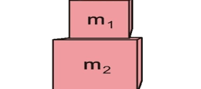
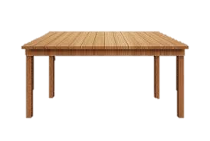
Example: Household Robot
Means- End Analysis
Suppose that the Robot in this domain were given the problem of moving a Desk with two things on it from one Room to another Room.
The main difference between the start state and the Goal state would be the location of the Desk.
Mr. Prayag Patel
Department: IT/ICT-LJIET

Slide 189
Household Robot Operators
Means- End Analysis
Operator | Preconditions | Results
PUSH(Obj, Loc) | At(robot, obj)^ Large(obj)^ Clear(obj)^ armempty | At(obj, loc)^ At(robot, loc)
CARRY(Obj, loc) | At(robot, obj)^ Small(obj) | At(obj, loc)^ At(robot, loc)
WALK(loc) | None | At(robot, loc)
PICKUP(Obj) | At(robot, obj) | Holding(obj)
PUTDOWN(obj) | Holding(obj) | ¬holding(obj)
PLACE(Obj1, obj2) | At(robot, obj2)^ Holding(obj1) | On(obj1, obj2)
Mr. Prayag Patel
Department: IT/ICT-LJIET

Slide 190
Difference Table
Means- End Analysis
 | PUSH | Carry | Walk | Pickup | Putdown | Place
Move Obj | * | *
Move robot |  |  | *
Clear Obj |  |  |  | *
Get object on obj |  |  |  |  |  | *
Get arm empty |  |  |  |  | * | *
Be holding obj |  |  |  | *
Mr. Prayag Patel
Department: IT/ICT-LJIET

Slide 191
MEA: Progress
Means- End Analysis
A
B
C
D
Push
Goal
start
A
D
B
C
E
walk
Pick
up
Put
Down
Place
Pick
Up
Put
Down
Push
Start
Goal
Mr. Prayag Patel
Department: IT/ICT-LJIET

Slide 192
Thank you for watching!
Mr. Prayag Patel
prayag.patel@ljinstitutes.edu.in

